Slide 1

PREDICTING THE NFL DRAFT
Ayo, Diala, Doug, Laura, Mark and Scott

Slide 2
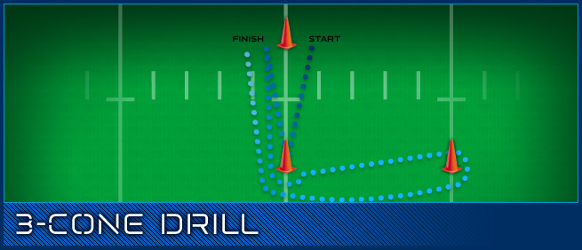
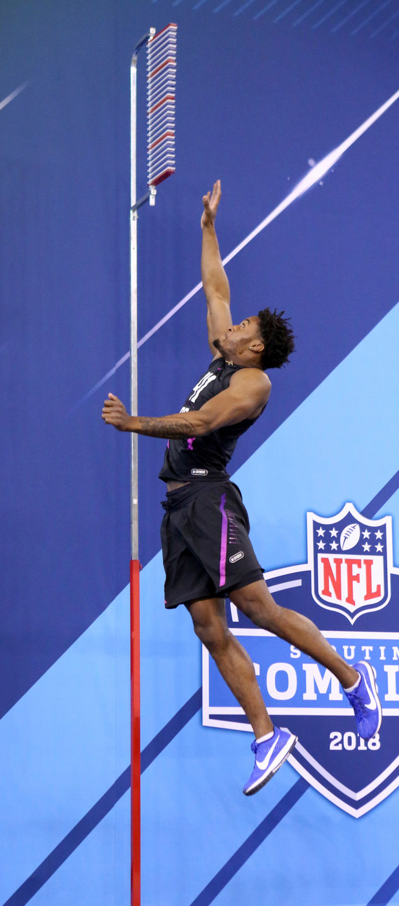
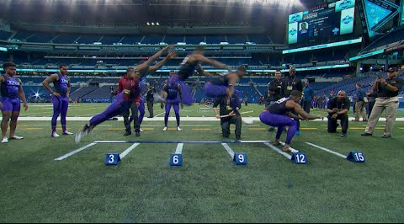
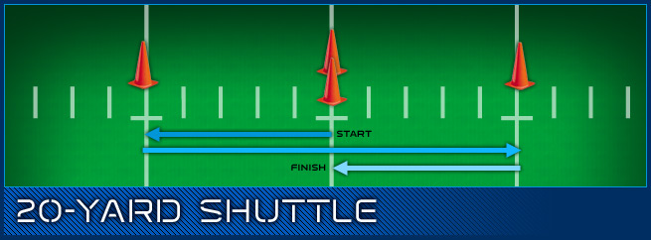
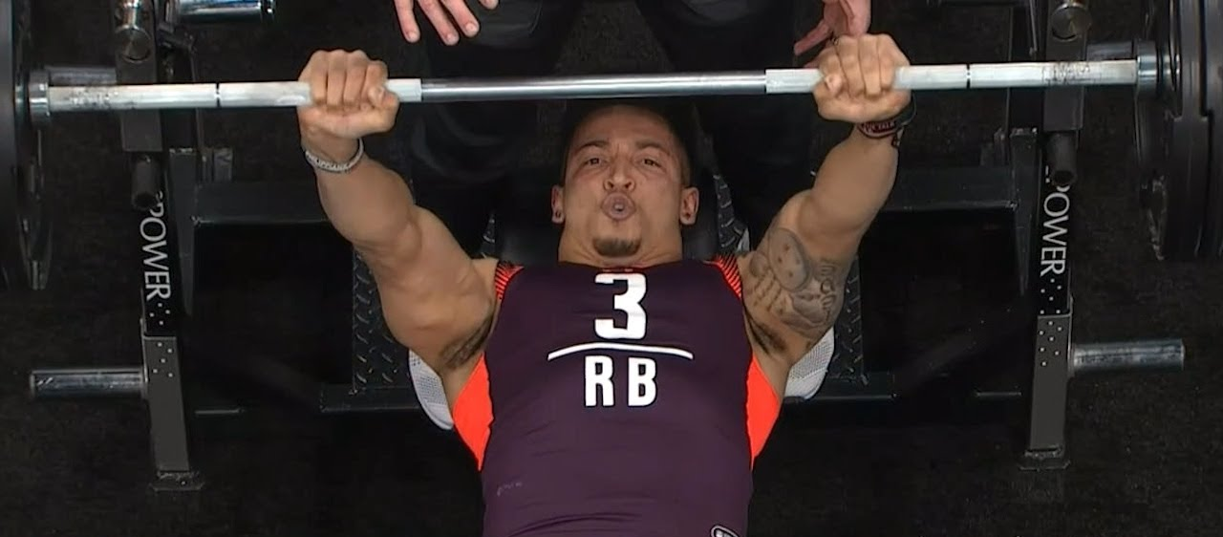
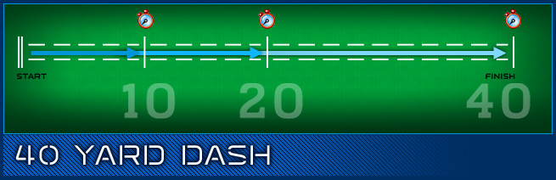
Pictures in case we want incorporate any for entertainment or information.

Slide 3
Data Sources
Scraped data
NFL Combine: http://nflcombineresults.com
NFL Draft: http://www.nfl.com/draft/history/fulldraft
Downloaded data
Kaggle: https://www.kaggle.com/kbanta11/nfl-combine
NFL Combine: http://nflcombineresults.com/nflcombinedata.php
2000 - 2019 NFL Draft Scouting Combine Dataset with the following: Height, Weight, 40-Yard Dash, Bench Press, Vertical Leap, Broad Jump, Shuttle, 3-Cone.
These indicators were used for the NFL draft.

Slide 4
Year | Complete Indicator Data?
 | No | Yes | Total
2000 | 189 | 134 | 323
2001 | 211 | 114 | 325
2002 | 185 | 137 | 322
2003 | 190 | 130 | 320
2004 | 206 | 130 | 336
2005 | 184 | 149 | 333
2006 | 169 | 161 | 330
2007 | 179 | 148 | 327
2008 | 178 | 152 | 330
2009 | 150 | 178 | 328
2010 | 164 | 162 | 326
2011 | 126 | 203 | 329
2012 | 150 | 175 | 325
2013 | 171 | 161 | 332
2014 | 166 | 170 | 336
2015 | 168 | 160 | 328
2016 | 172 | 160 | 332
2017 | 173 | 156 | 329
Total | 3,131 | 2,780 | 5,911
Training
Complete Cases to Use for Modeling
N = 2,624
Testing
Model Creation & Refinement
New Cases
N = 156
New Predictions

Slide 5
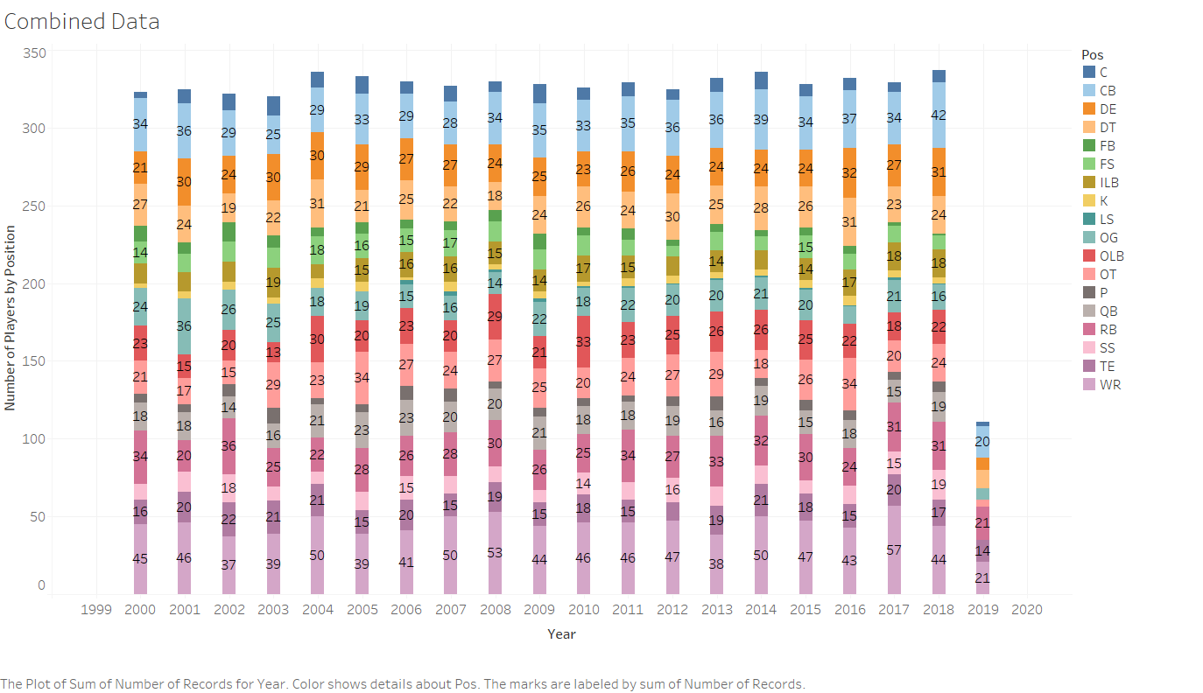
Used the raw data to create a bar chart showing the number of players by position by year. As shown below:

Slide 6
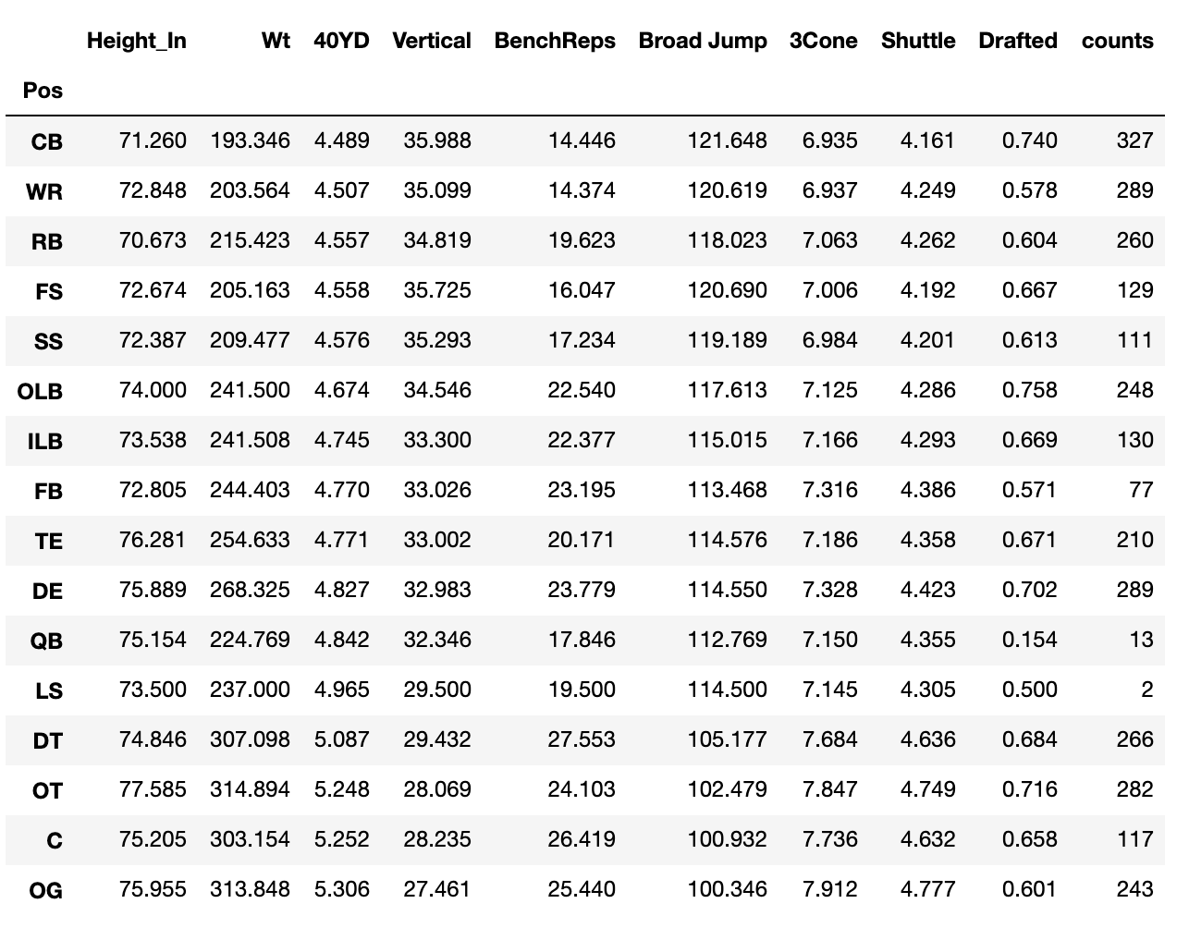
Original data was filtered to get the years 2000 and beyond.
For the columns 3Cone, 40yd and shuttle, we omitted values equal to 9.99 as this was a recurring error.
Another data frame was extracted containing the columns "Pos","Height_In","Wt","40YD", "Vertical","BenchReps","Broad Jump","3Cone","Shuttle","Drafted” without null values.
This is a summary of the Mean indicator values.

Slide 7
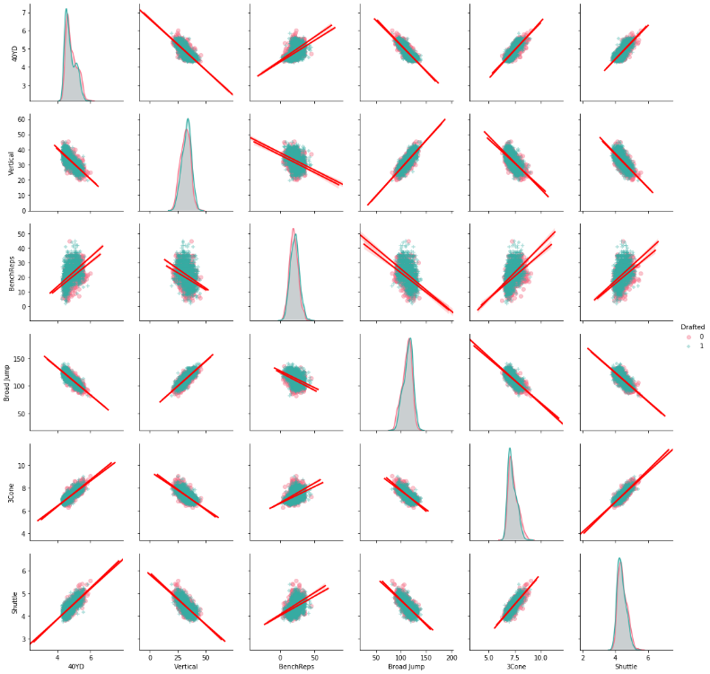
We created the first pairplot for each indicator in the combine data, the two different colors show the difference between drafted and the non-drafted players. As shown below:
As you can see, there is a high correlation between the individual indicators. However, the Bench Press has the weakest correlation among the individual indicators

Slide 8
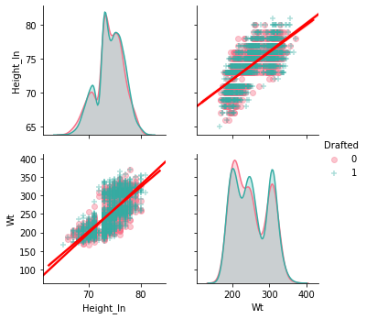
The second pairplot shows the relationship between the mean value for height and weight for all players.

Slide 9
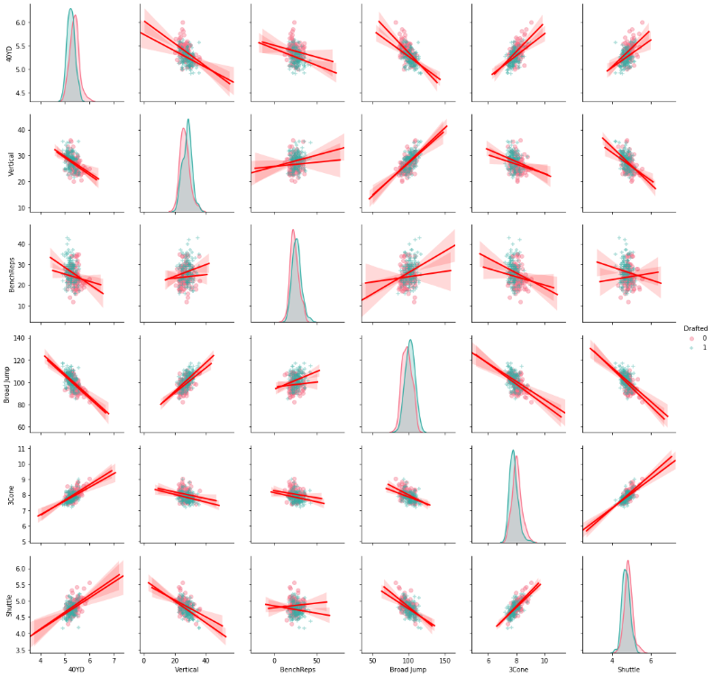
The third pairplot shows the relationship between the mean value for all indicators for the Offensive Guard position specifically.

Slide 10
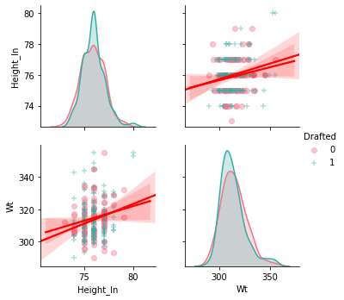
The fourth pairplot shows the relationship between the mean value for height and weight for Offensive Guard.

Slide 11
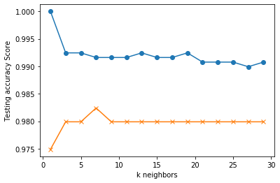
Can we predict: Is this person a lineman or not?

Slide 12
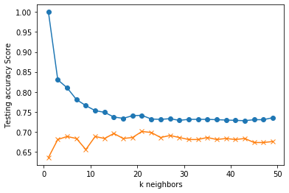
Can we predict: Does this person play defense or offense?

Slide 13
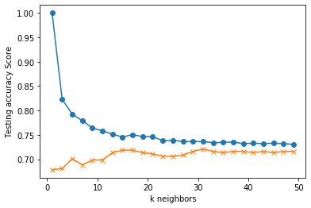
Can we predict: The broad category does this person fall into?

Slide 14
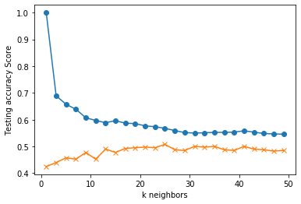
Can we predict: What is the actual position of a player?

Slide 15
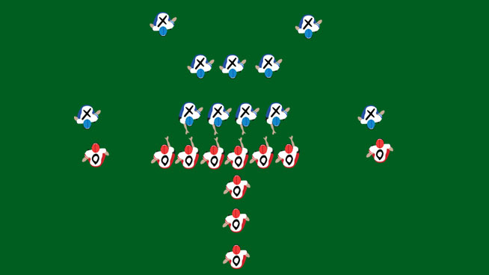
Can we develop a model to predict who will be drafted based on NFL Combine Results?
In partial answer to this, we chose to focus on Offensive Guard after examining all other possibilities
Offensive Guard

Slide 16
Can we develop a model to predict who will be drafted based on NFL Combine Results?
Prior to model building we create a tree diagram of probability of being drafted by combine results…next page
Offensive Guard

Slide 17
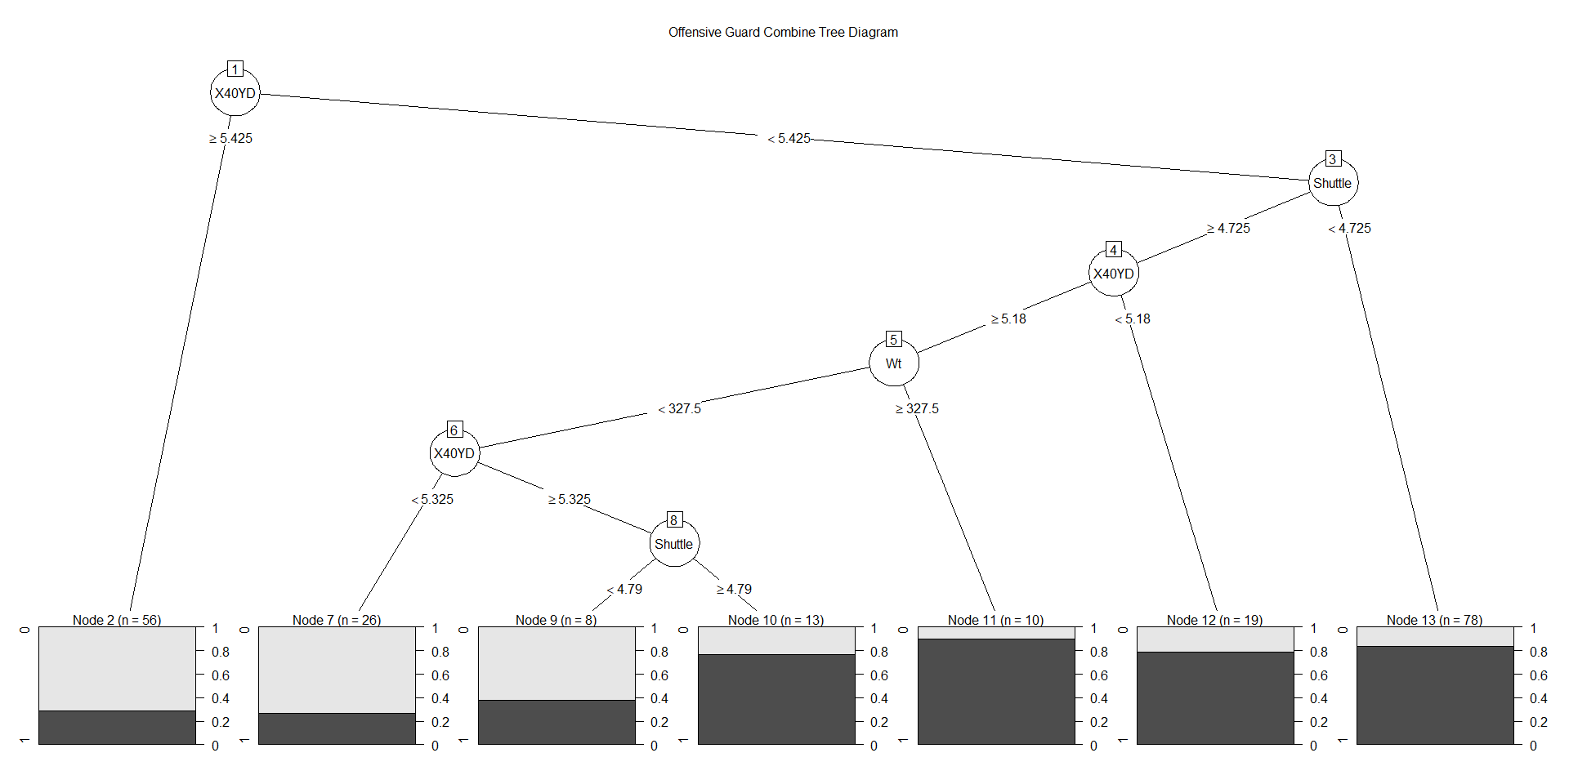
Can we develop a model to predict who will be drafted based on NFL Combine Results?
Prior to model building we create a tree diagram of probability of being drafted by combine results
Offensive Guard

Slide 18
Can we develop a model to predict who will be drafted based on NFL Combine Results?
Began with Random Forest defaults, attempted to optimize the number of trees to sample
See next page
Offensive Guard

Slide 19
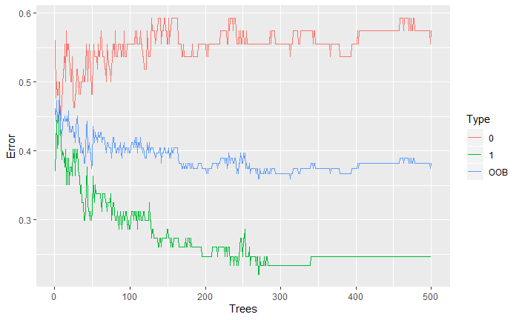
Can we develop a model to predict who will be drafted based on NFL Combine Results?
Began with Random Forest defaults, attempted to optimize the number of trees to sample
See next page
275
Offensive Guard

Slide 20
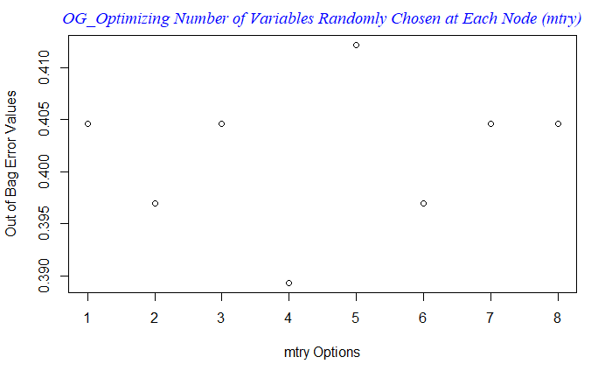
Can we develop a model to predict who will be drafted based on NFL Combine Results?
Then optimized the mtry parameter.
Offensive Guard
4

Slide 21
Can we develop a model to predict who will be drafted based on NFL Combine Results?
Also ran default Naïve Bayes and tuned Logistic Regression
All models produced results better than chance in the test sample
Which model provided the best results in the test sample?
Next page.
Offensive Guard

Slide 22
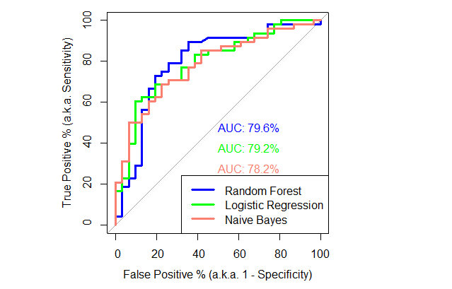
Can we develop a model to predict who will be drafted based on NFL Combine Results?
All models produced results better than chance in the test samples
See Next page.
Offensive Guard

Slide 23
Can we develop a model to predict who will be drafted based on NFL Combine Results?
Which model provided the best results in predicting the next years drafts?
Next page.
Offensive Guard

Slide 24
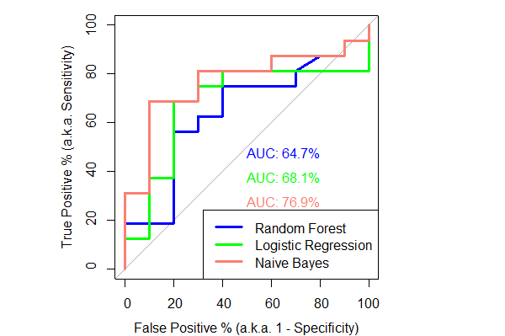
Can we develop a model to predict who will be drafted based on NFL Combine Results?
275
Offensive Guard

